Slide 1

Encryption in virtualized 5G environments
VladD

Slide 2

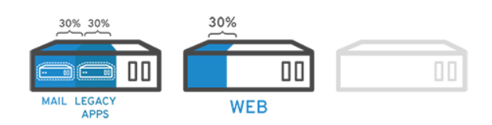

What is virtualization and why use it ?
Virtualization: “a technology that let you create useful IT services using resources that are traditionally bound to hardware. It allows you to use a physical machine’s full capacity by distributing its capabilities among many users or environments.” (RedHat, https://www.redhat.com/en/topics/virtualization/what-is-virtualization)
For added flexibility we want to be able to virtualize most of the components needed in 5G. This also means the ciphering part of 5G.
The only part that needs to be physical are the radio antennas and amplifiers.

Slide 3
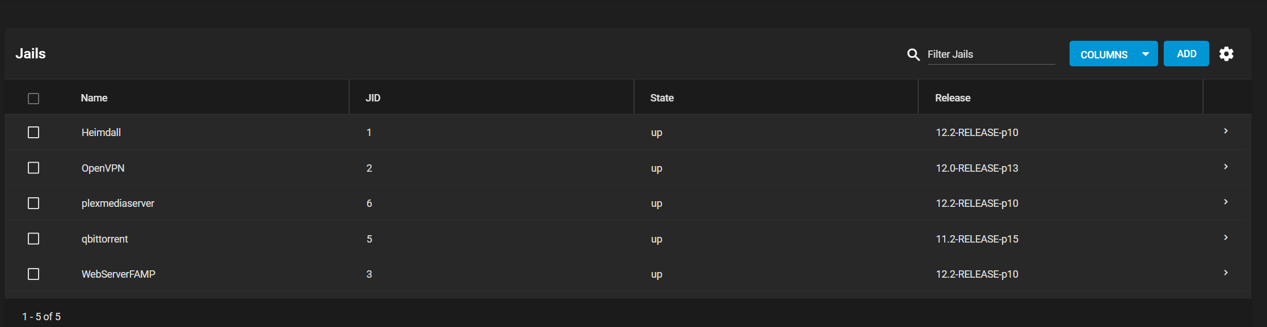
A personal example:

Slide 4
Why new algorithms ?
The 5G standard has very high speed necessities for air encryption. Over 20Gbps !
We need better performance and more flexibility.
The security should withstand advances in cryptanalysis. For example: a quantum attack.

Slide 5
A little about performance
Because we need to be able to run the algorithms in the cloud (and for keeping the costs low) we cannot base our algorithms on specific hardware (Ex: ASICs – Aplication Specific Integrated Circuit).
We want to achieve the speed needed for 5G in software. ITU (United Nations agency for information and communication) 20 Gbps for downlink, so we need > 20 Gbps to not be a bottleneck.
We also said that we want a bigger key size (256 bit) so the ciphering algorithms also need to be able to store and manipulate such keys.

Slide 6
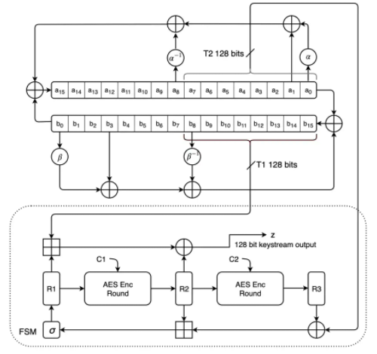
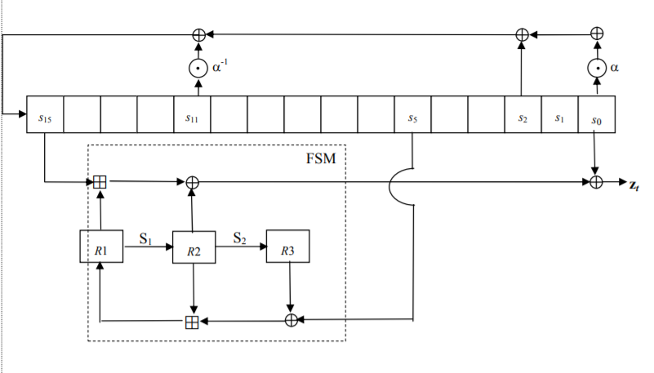
THE SNOW-3G VS snow-v algorithm
https://tosc.iacr.org/index.php/ToSC/article/view/8356

Slide 7
Snow-v an update to snow 3g
Developed by Ericsson Research and Lund University.
SNOW-3G is currently used in 4G. So, for SNOW-V the developers kept the best parts but optimized the algorithms for software implementations.
Uses standard AES hardware acceleration that is available in all modern CPUs.
Uses 256-bit keys.

Slide 8
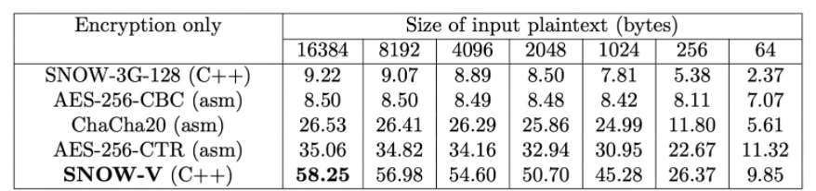
Software performance
The algorithm is compared to the old SNOW-3G and AES-256. AES-256 is used in TSL and IPSec so it’s a good competitor.
The numbers are in Gbps and the test is run on an Intel laptop.
https://tosc.iacr.org/index.php/ToSC/article/view/8356

Slide 9
Conclusion
Because of the trend of cloud computing and the increase of transfer speeds in 5G, the encryption algorithms should to be designed with virtualization and speed in mind.
We have seen that SNOW-V can run in virtualized environments and sustain speeds over 20 Gbps.
We now only need the proof of time that the algorithm is secure enough. The researchers say that the algorithm is resistant to all attacks known today.

Slide 10
References
https://tosc.iacr.org/index.php/ToSC/article/view/8356 - the SNOW-V specifications (2019)
https://www.gsma.com/aboutus/wp-content/uploads/2014/12/snow3gspec.pdf - 3GPP specification of SNOW-3G (2006)
https://www.ericsson.com/en/blog/2020/6/encryption-in-virtualized-5g-environments - article about SNOW-V
https://dl.acm.org/doi/10.1145/3448300.3467829 - article about SNOW-Vi

